Slide 1
Snake Arena
Project member - Barry Chan, Leo Chor, Andy Leung

Slide 2
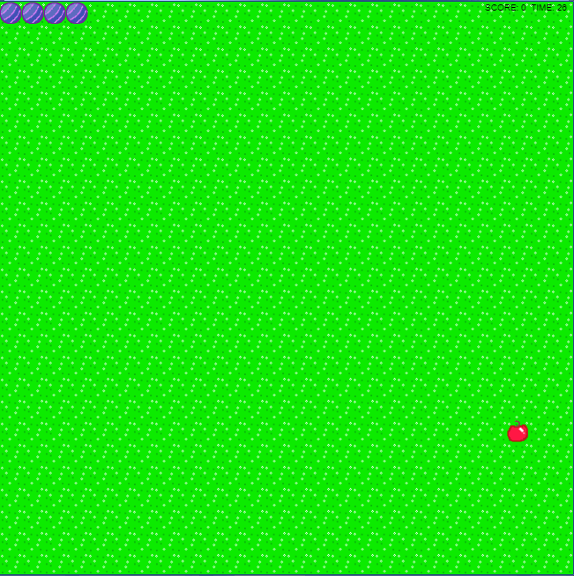

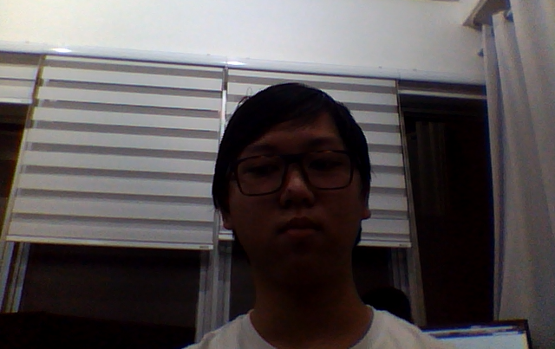
Controls/Gameplay
Time Racing

Slide 3



Used Technology
Backend
Express
Postgresql
AWS

Slide 4






Used Technology
Frontend
HTML5
NodeJS
ReactJS
React-redux
SCSS
Tensorflow

